Slide 1
Energy Loss and The Pyramid of Biomass
Miss Scharback

Slide 2
Let’s Review
What is a decomposer?
What is a producer?
What is a consumer?
What is a secondary consumer?

Slide 3
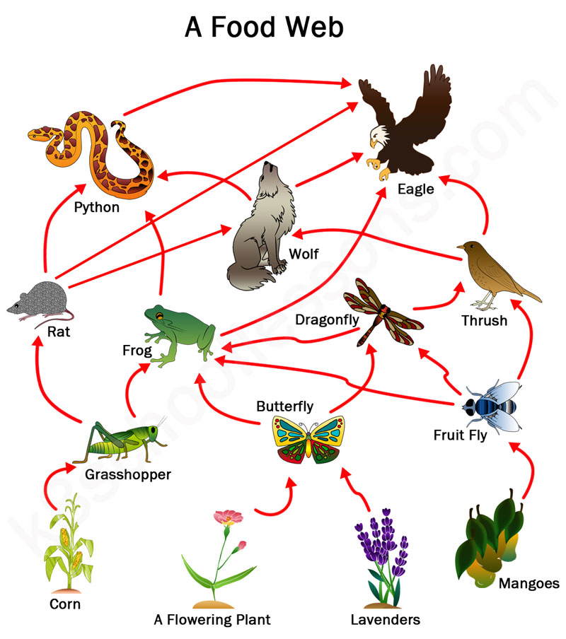
What is a Food Web?
A network of food chains or feeding relationships by which energy or nutrients are passed on from one species of living organisms to another.
Each arrow on the diagram shows a pathway of energy.

Slide 4
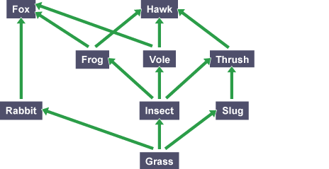
Deeper Thinking Question
Considering the food web above as an example, what would happen if the population of slugs decreased?

Slide 5
Answer
“Slugs, rabbits and insects all eat grass. If there were fewer slugs there would be more grass for the rabbits and insects. With more food available, the populations of rabbits and insects would increase.”
“However, the thrushes would have to eat more insects to maintain their population, so it is also possible that the population of insects could decrease. This may reduce the populations of voles and frogs.”
https://www.bbc.co.uk/education/guides/z2m39j6/revision/2

Slide 6
What is a Tertiary Consumer?
A carnivore at the top/highest level in a food chain that feeds on other carnivores.
Some examples of tertiary consumers are hawks, humans, sharks, lions, etc.

Slide 7
What is a Trophic Level?
The levels in an ecosystem where a series of organisms share the same function in the food chain and the same relationship as sources of energy.
So what does this mean? What does this look like?

Slide 8
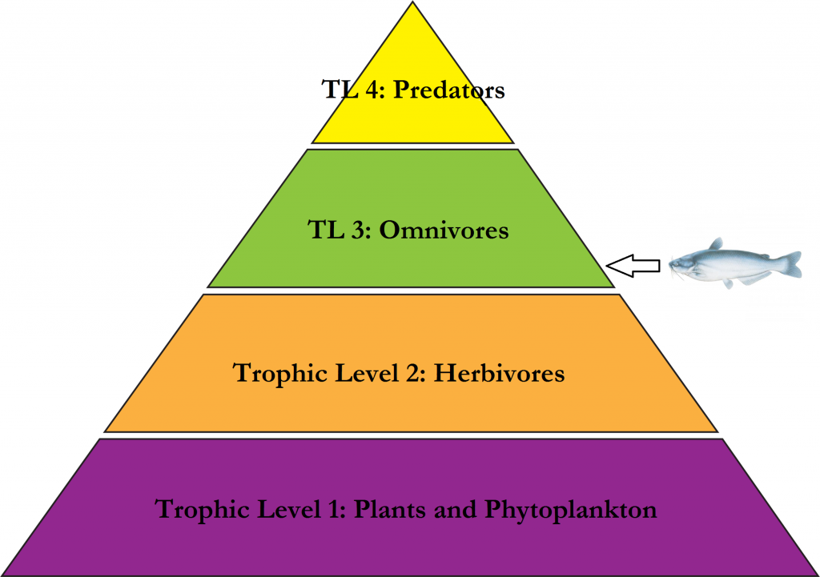

Slide 9
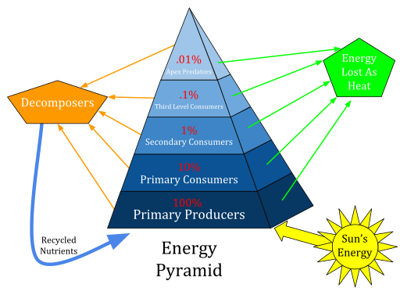
Pyramid of Biomass
The pyramid shows the transfer of the amount of energy through each trophic level.
10% of the energy is passed on through each level and the other 90% is released into the atmosphere as heat

Slide 10
Let’s practice determining how much energy is lost in different situations

