Slide 1
Ecosystems in Saskatchewan
Miss Scharback

Slide 2
Prairie Grasslands
Landscapes range from being flat to lush wooded valleys
Grass is the foundation of the prairie and makes up 80% of prairie land
The grasslands mainly cover central and southern Saskatchewan
Animals that inhabit this ecosystem are gophers, foxes, deer, skunks, porcupines, rabbits, etc.
The Grasslands are one of North America’s most threatened ecosystems.
“Only about 4% of Saskatchewan’s 24 million hectares of original prairie landscape remains in native vegetation and good ecological condition.”

Slide 3
Prairie Grasslands

Slide 4
Sand Hills
Located in southwestern Saskatchewan (close to the town of Leader)
Mule deer and Antelope are frequent animals in the area
They are the largest set of sand dunes in Canada.
They are a protected area and ecological reserve
The sand covers 1,900 square kilometers

Slide 5
Sand Hills

Slide 6
Wetlands
Commonly known as sloughs and marshes
Common wildlife visitors are shorebirds, ducks, gulls, and other species of birds.
They are usually affected by drought, yet the water returns every year.
Wetlands are low-lying areas covered by water that allow aquatic life and plants to prosper.

Slide 7
Wetlands

Slide 8
Lakes
A lake is a large body of water that is surrounded by land
Lakes are prosperous for fishing. Saskatchewan lakes commonly have fish such as Walleye (Pickeral), Northern Pike (Jack), Lake Trout, Arctic Grayling, Rainbow Trout and many others
Lakes are located all over the province and they vary in size.

Slide 9
Lakes

Slide 10
Visual of Lakes in Saskatchewan

Slide 11
Rivers
The two commonly known rivers in Saskatchewan are the North Saskatchewan River and the South Saskatchewan River
The Saskatchewan River branches into two sections that flow from the mountains until they hit Lake Winnipeg.
A river is a natural stream of water that flows to another larger body of water.

Slide 12
Rivers

Slide 13
Map of Rivers in Saskatchewan

Slide 14
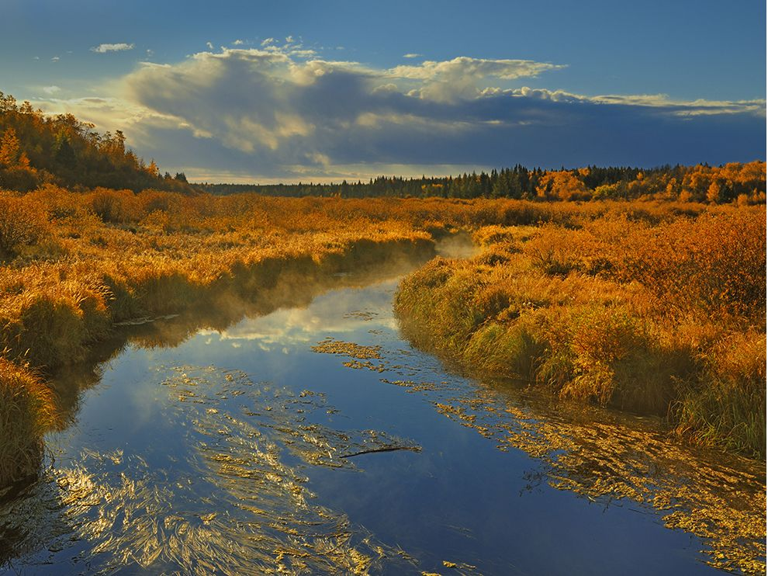
Bogs
Bogs are commonly located in Northern Saskatchewan
A bog is a type of wetland that consisted of accumulated dead and decaying material.

Slide 15
Forests
A forest is a large land area covered with trees and other woodland plants.
Animals that inhabit this area are bears, moose, elk, etc.
Saskatchewan landscape is actually more than half made of forests
The Forest Zone takes up 11.7 Million hectares.
There is a large industry for timber harvesting in Saskatchewan
The Forest Zone is located in the Northern half of the province

Slide 16
Forests

Slide 17
Map of the Forests in Saskatchewan

Slide 18
What does “Abiotic” mean?
An abiotic component is something that is not living.
Examples of Abiotic components in an ecosystem:
Water
Sunlight
Rocks
Air
Dissolved Oxygen (in water)
Salinity (dissolved salt)
Soil

Slide 19
What does “Biotic” mean?
A biotic component is a living organism.
Examples of Biotic components in an ecosystem:
Animals
Plants
Bacteria
Fungi

Slide 20
Characteristics of Living Things
They can reproduce
They maintain homeostasis
They require energy
They grow and develop
They evolve
They are made of one or more cells
They respond to stimuli
They are organized and have a shape

Slide 21
Resources
http://cpaws-sask.org/campaigns/prairies
https://greatsouthwest.ca/great-sandhills/
http://www.southsaskriverstewards.ca/ckfinder/userfiles/files/ManagingSaskatchewanWetlands.pdf
http://www.tourismsaskatchewan.com/things-to-do/fishing/what-youll-catch
http://www.environment.gov.sk.ca/Default.aspx?DN=4c4d5d1f-be8d-4849-9783-d028ab3347dc
https://www.saskatchewan.ca/business/invest-and-economic-development/key-economic-sectors/forestry

Slide 22
Task Time

