Slide 1
Sources of Energy
Miss Scharback

Slide 2
What is an Ecosystem? (Let’s Review)
An ecosystem is a biological community of interacting organisms and their physical environment.
In your table groups, try and deconstruct/ break down these big words to create a definition that makes sense to you and then we will share thoughts as a class.

Slide 3
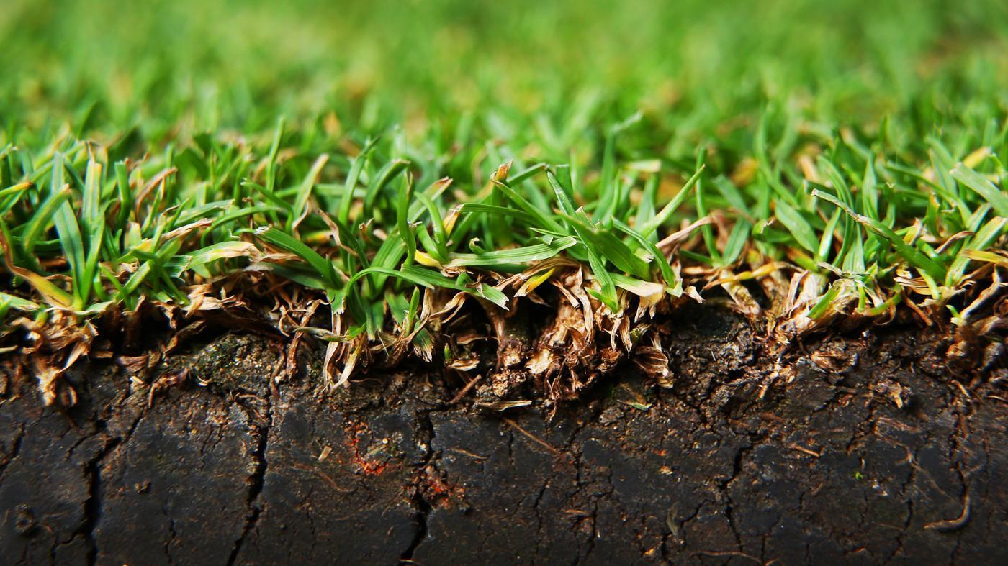
Producers
A producer is able to make/create their own food and is an energy source for other organisms.
Producers use a process called Photosynthesis. Photosynthesis is the process when a plant uses sunlight to combine water and carbon dioxide to create their food, grow, and release __________ into the air.

Slide 4
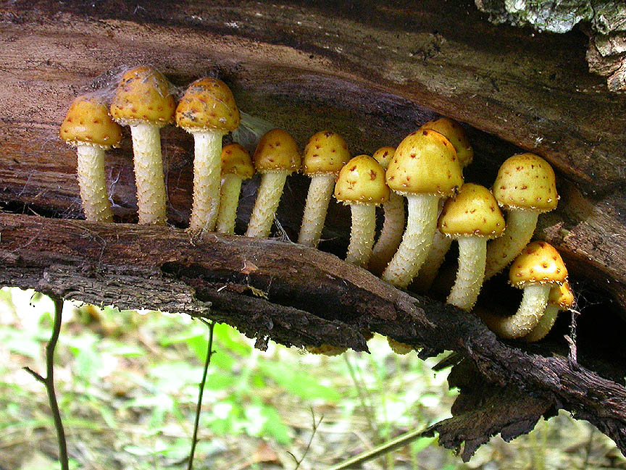
Decomposers
A decomposer is an organism that breaks down organic material. Organic material is material such as plant and animal _________. These are things such as tree trimmings, fallen leaves, and animal manure.

Slide 5
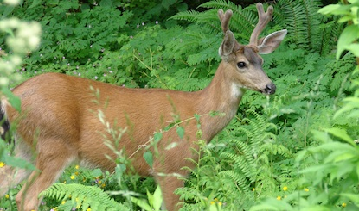
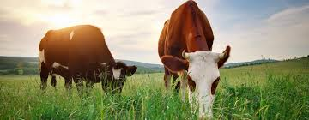
Consumers
A consumer is an organism that feeds on plants or other organisms as a source for _________.

Slide 6
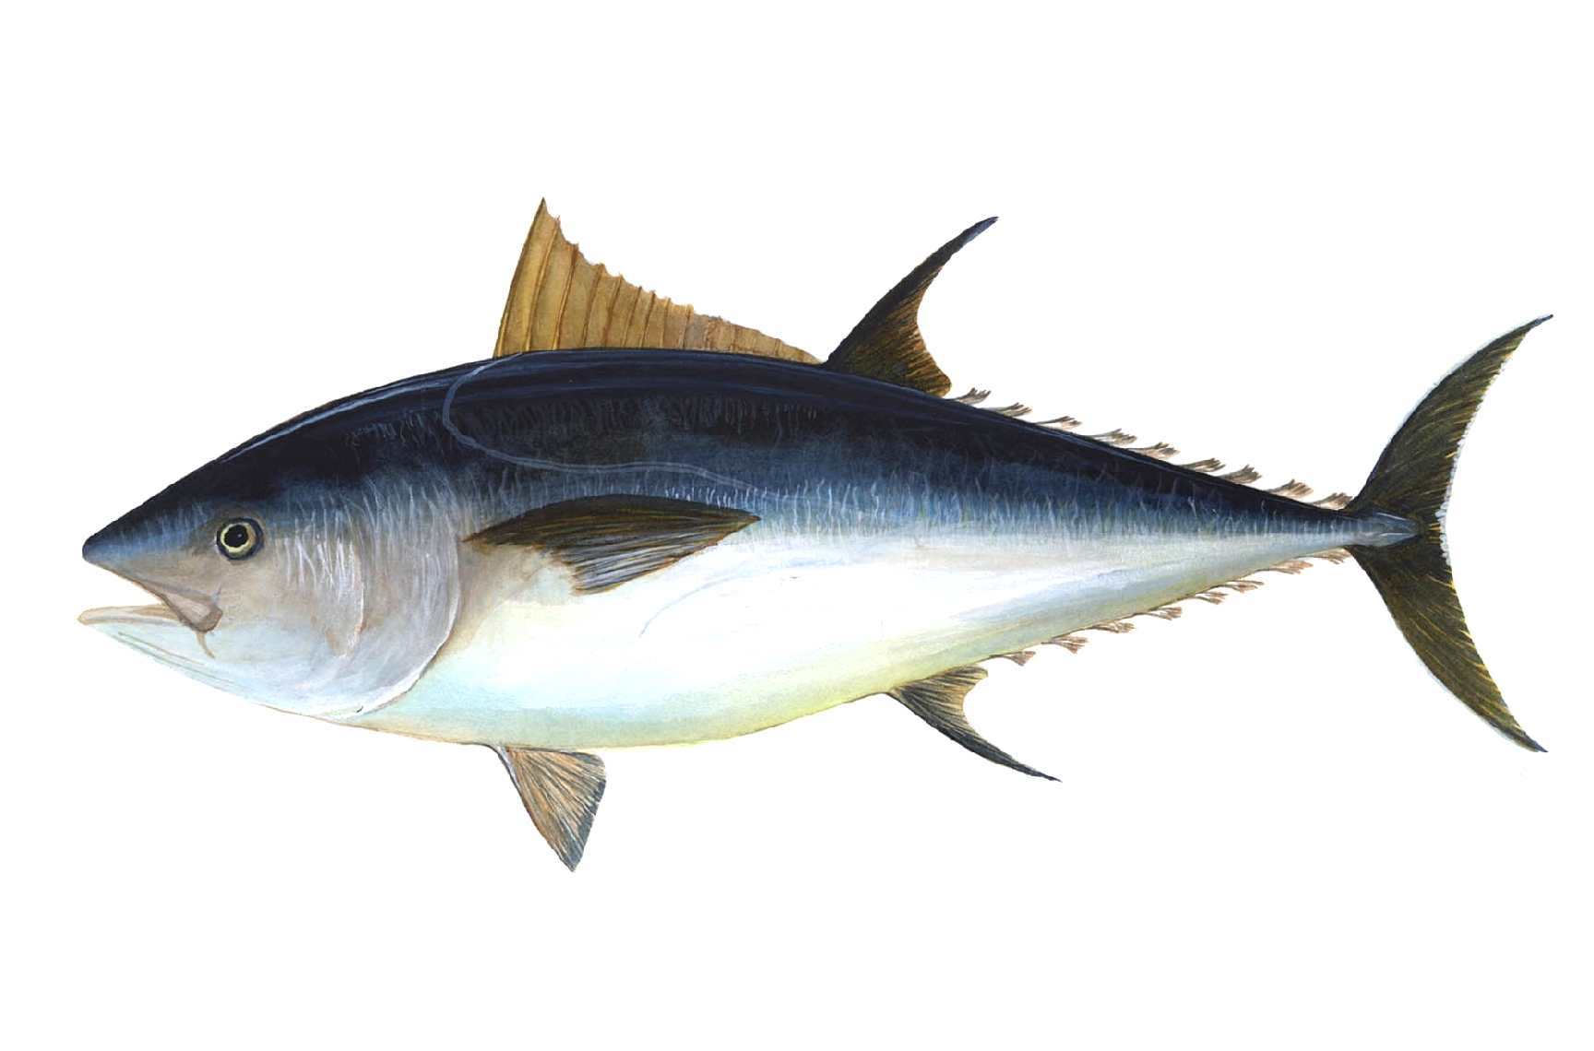
Secondary Consumers
Secondary consumers are described as meat eaters (_______) or meat and plant eaters (________).

Slide 7
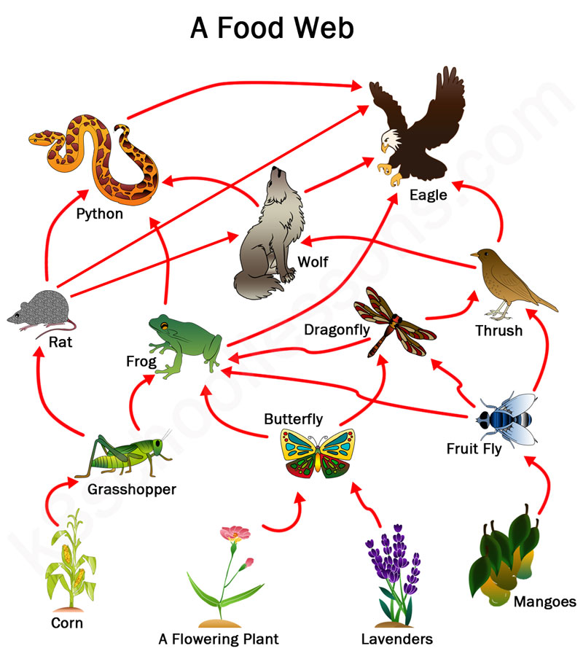
What is a Food Web?
A food web is a complex diagram representing all of the energy _________ in an ecosystem.
What does a food web look like?

Slide 8
What is a Food Chain?
A set of organisms that are each dependent on the other as a source of __________.
Here is what a food chain could look like:

Slide 9
Let’s watch a video! ☺
https://www.youtube.com/watch?v=MuKs9o1s8h8

Slide 10
Task Time
Your job is to create five small food chains within your table groups on the chart paper provided. Your NAMES MUST BE ON IT!
You will be given a magazine(s) to look through and find, cut out, and paste pictures of producers, consumers, and secondary consumers on chart paper.
If you have one or two pictures from the magazine and you cannot find a third one, you are allowed to draw a picture or pictures to complete the food chain.
You MUST label underneath your pictures whether it is a decomposer, producer, consumer or secondary consumer.
You will explain your classification methods to the class after completion.

